Slide 1
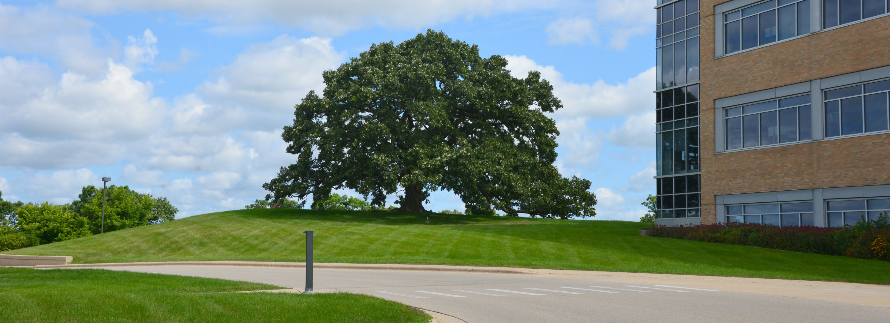
Growing Wisconsin Food and Agricultural Exports
International Agribusiness Center
November 15, 2023 - Wisconsin Agricultural Export Advisory Council Webinar
Notes:
The Department of Agriculture’s mission is to partner with all the citizens of Wisconsin to grow the economy by promoting quality food, healthy plants and animals, sound use of land and water resources, and a fair marketplace.
The International Agribusiness Center is part of the Agricultural Development Division which is dedicated to helping Wisconsin’s Food, Forestry and Agriculture Companies grow their business in the state, nationally and globally though one on one technical assistance, trade promotion activities and funding through federal and state sources. The contribution of agriculture to the state’s economy is $104.8 billion. Exports are an important component of that economic impact.

Slide 2
Wisconsin Agricultural Export Advisory Council Webinar – November 15, 2023
Agenda
Welcome and Opening Remarks
Randy Romanski, DATCP Secretary
Katy Sinnott, WEDC Global Trade and Investment
Agricultural Roads Improvement Program Update
Jennifer Murray, Wisconsin Department of Transportation Director – Bureau of Transit, Local Roads, Railroads & Harbors
Exports and ESG (Environmental, Sustainability, Governance)
Kimberly Paris, Senior Vice President, Environmental & Social Business Advisory – Bank of America
Matthew Terreni, Business Development Manager – SEDEX
Adjourn

Slide 3
International Agribusiness Center
Trade Promotion Activities - Active Recruitment FY2024
Australia International Dairy Week Mission, January 11-14, Sydney, Australia, Recruiting 3 Companies — livestock, feed, genetics, supplements
WEDC Mexico Trade Venture with DATCP, Mexico City and Monterrey, January 28–February 2, Recruiting 4 companies — packaged foods, food ingredients, pet foods, beverages
Wisconsin Cheese Promotion Mission Thailand, Bangkok and Chang Mai, January 29 to February 3, Recruiting 6 companies — cheese
Hong Kong International Fur Fair, Hong Kong, February 13-15, Recruiting 2 companies

Slide 4
International Agribusiness Center
Trade Promotion Activities - Active Recruitment
Food Export Mission Costa Rica and Guatemala, March 4-8, Recruiting 3 companies — dairy products
International Food Exhibition, London, England, March 25-27, Recruiting 4 companies — packaged foods, food ingredients, pet foods, beverages
WEDC Canada Trade Venture with DATCP, April 7-11, Toronto and Winnipeg, Recruiting 3 companies — packaged foods, food ingredients, beverages
ANUGA Show Select, São Paulo, Brazil, April 9-11, Recruiting 3 companies — packaged foods, food ingredients, pet foods, beverages

Slide 5
International Agribusiness Center
Trade Promotion Activities - Active Recruitment
Secretary-led Mission, Santiago, Chile, May 6-10, Recruiting 6 companies — packaged foods, food ingredients, beverages, livestock, genetics, feed, wood
Thaifex Show, Bangkok, Thailand, May 28 – June 1, Recruiting 5 companies — packaged foods, food ingredients, beverages
Alimentec Show Bogotá, Colombia, June 18-21, Recruiting 3 companies — packaged foods, food ingredients, beverages
For more information on Trade Promotion Activities, please visit:
  DATCP Home International Agribusiness Center Calendar (wi.gov)

Slide 6
Thank you!
International Agribusiness Center
Lisa Stout, International Agribusiness Center
lisa.stout@wisconsin.gov | 608-514-4538 | datcp.wi.gov/Pages/AgDevelopment/InternationalAgribusiness.aspx
November 15, 2023

